Slide 1
WebRTC implementation

Slide 2
Problem statement
Given two browsers on separate machines, labeled A and B.
The objective is to enable browser B to replicate the display of browser A, which may include both text and video content.
Demo video and source code are available at:
https://drive.google.com/drive/folders/1WCCFjsJOU1tIcymR338xXbOsjPe72-CX?usp=sharing
Github: https://github.com/ngochungnguyenlg/webRTCDemo/

Slide 3
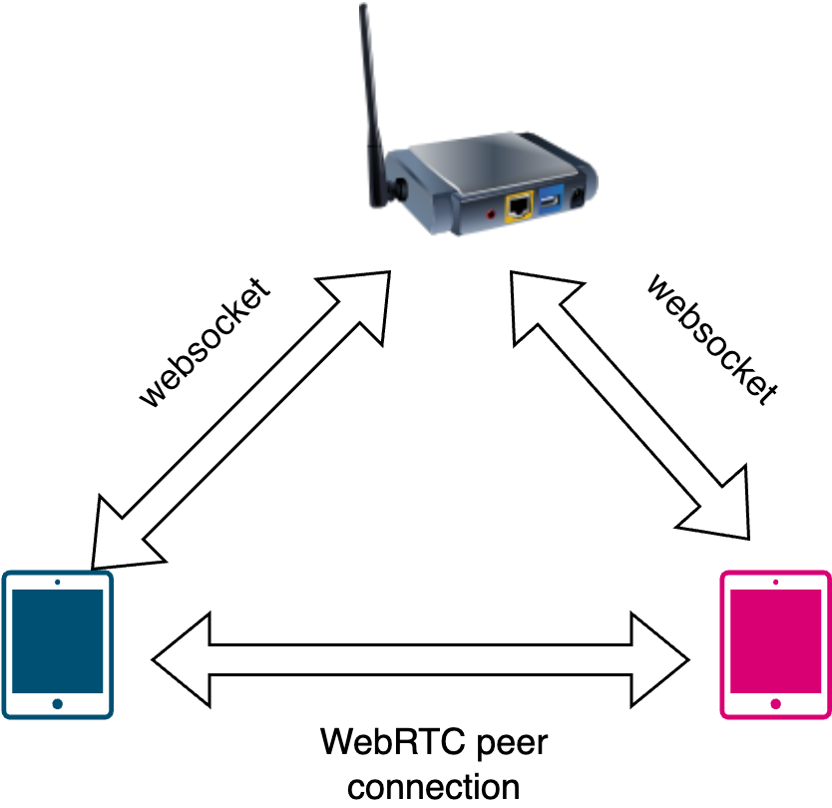
System overview
The approach of this implementation is based on WebRTC supported by Websocket.
In this design, two devices need to establish a WebRTC peer to peer (p2p) connection.
In the beginning, these two devices cannot connect directly due to the connection limitation by: ip-address, port, firewall, …. Therefore, a signaling server is a key to solve these problems.

Slide 4
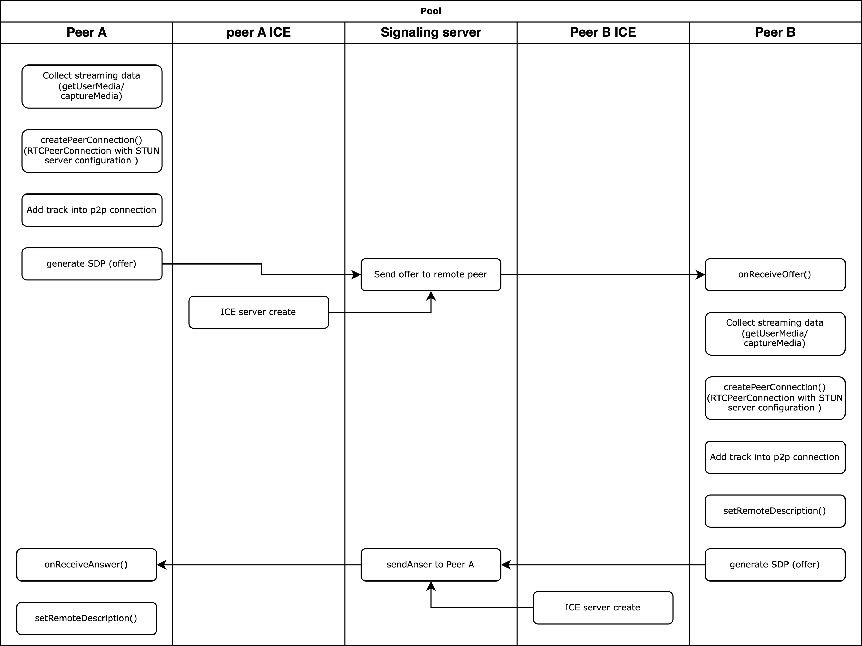
WebRTC Sequence

Slide 5
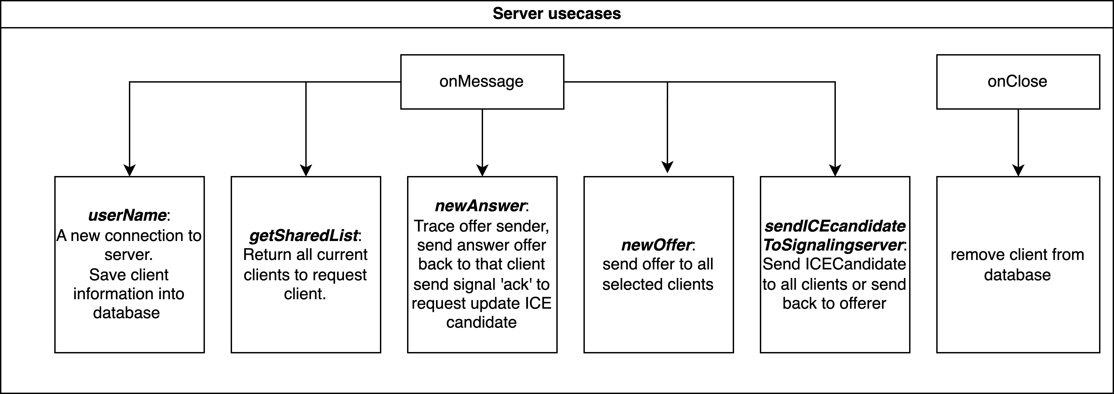
Server Usecases

Slide 6
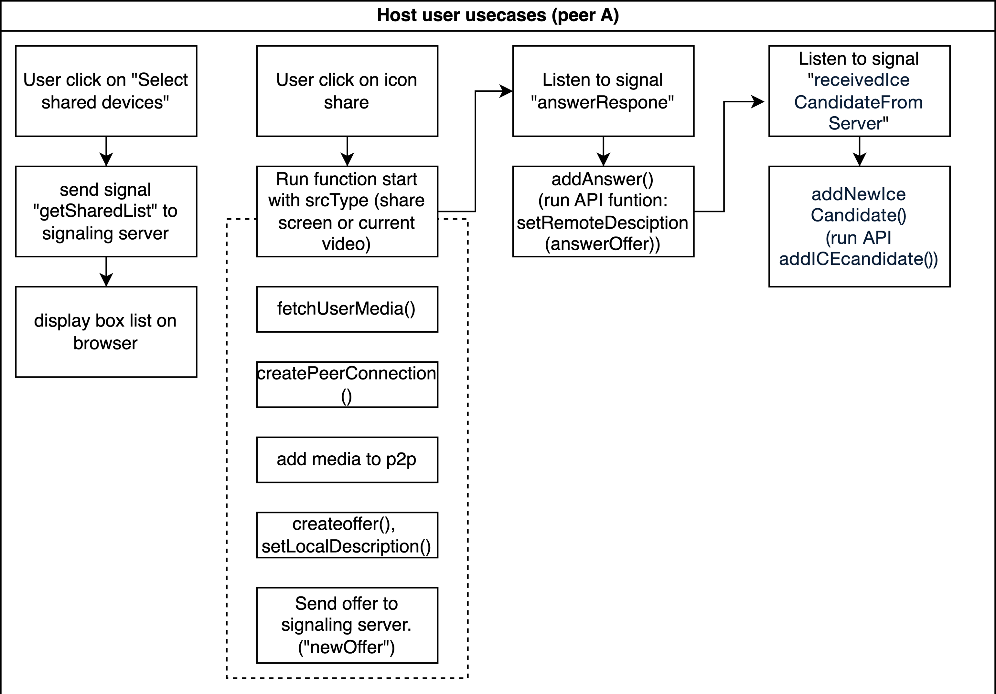
Host sequence (Peer A)

Slide 7
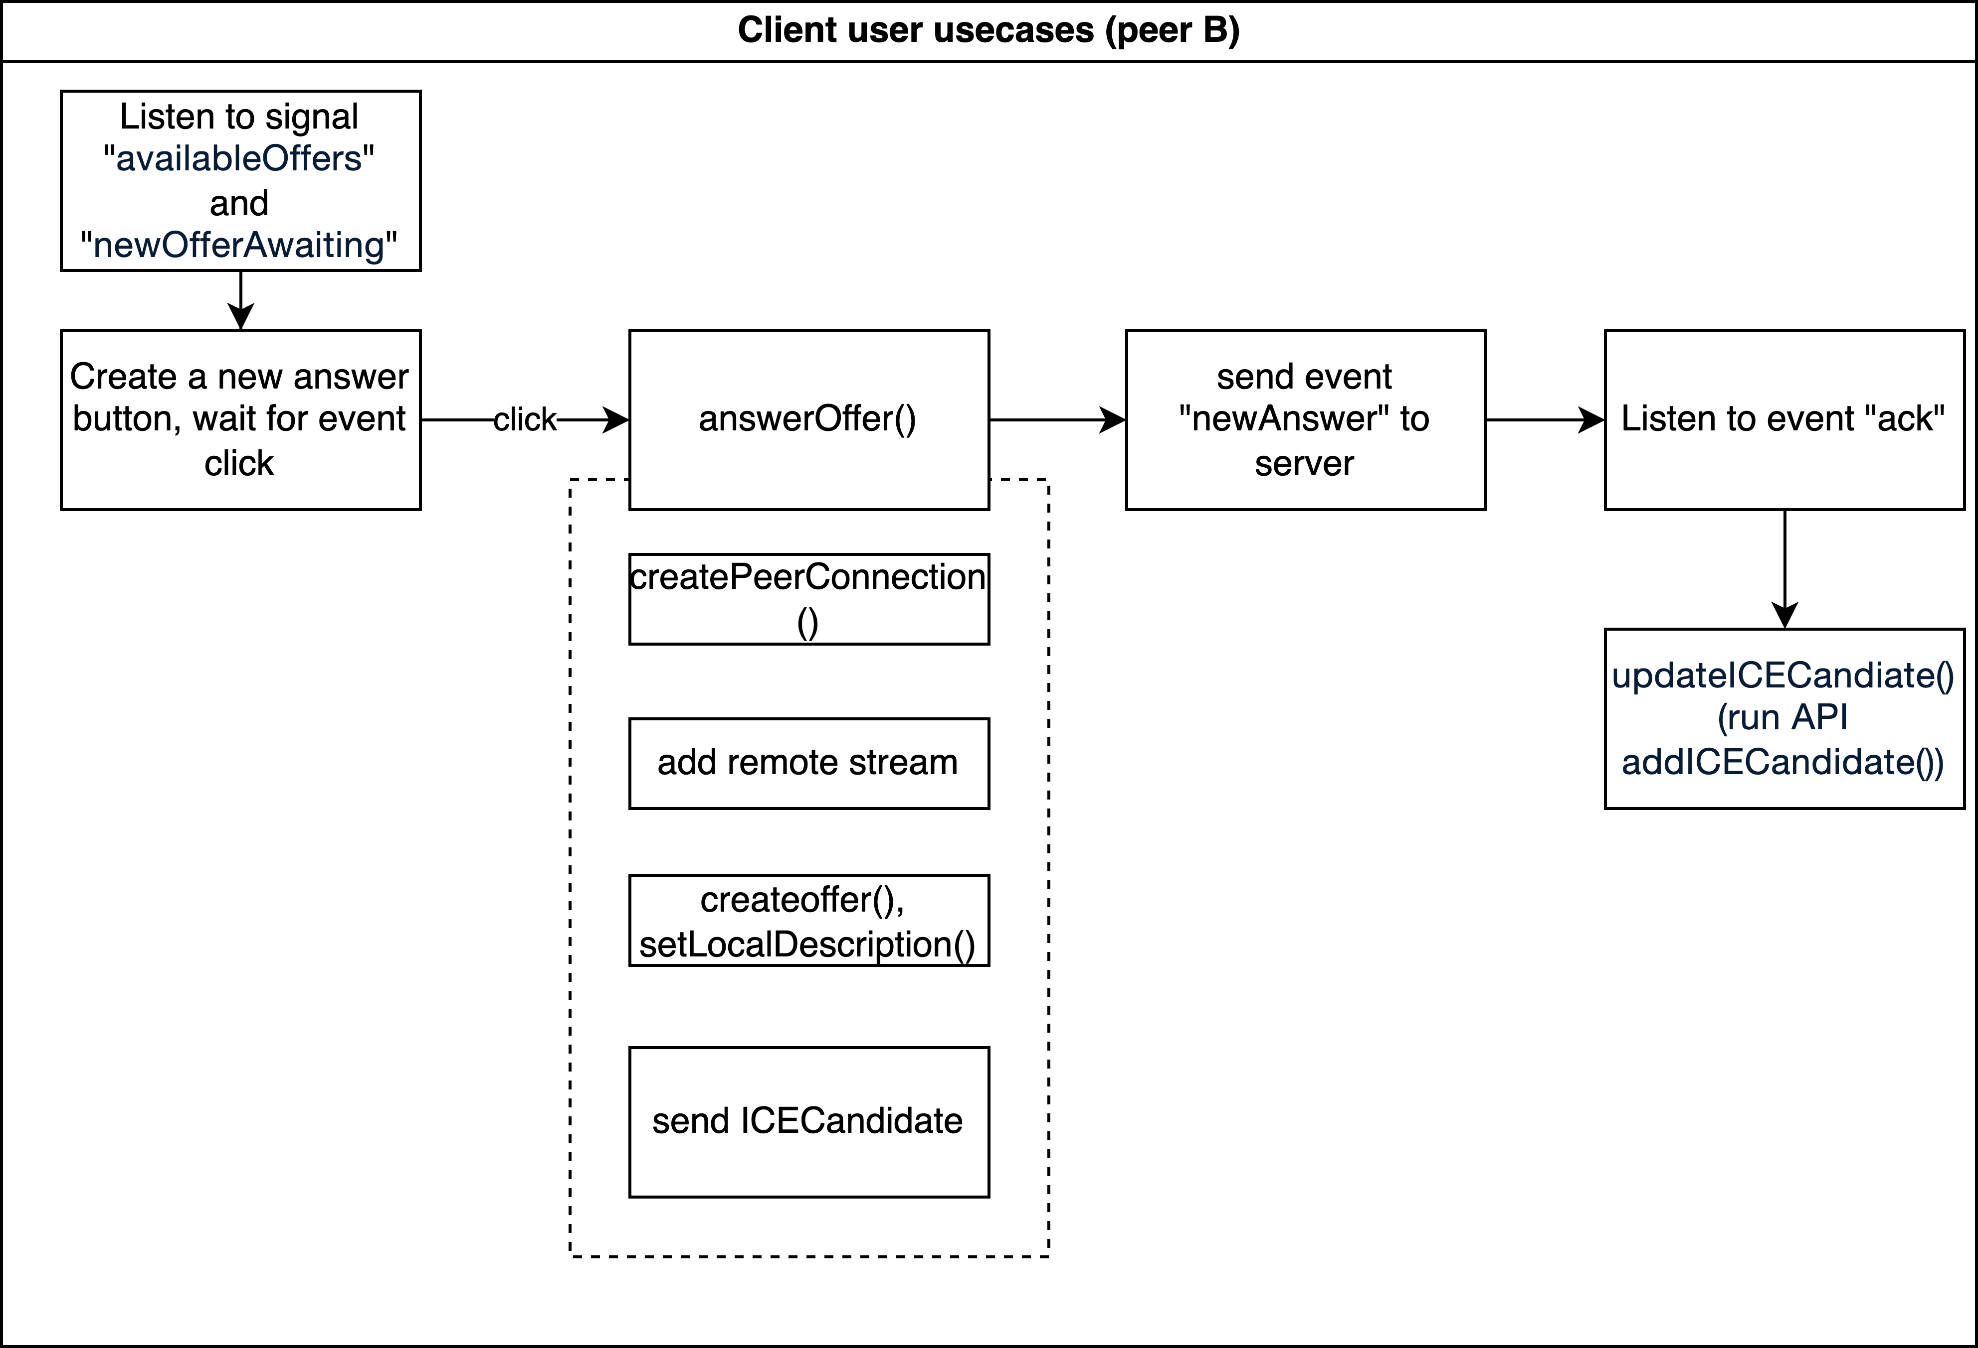
Client sequence (Peer B)

Slide 8
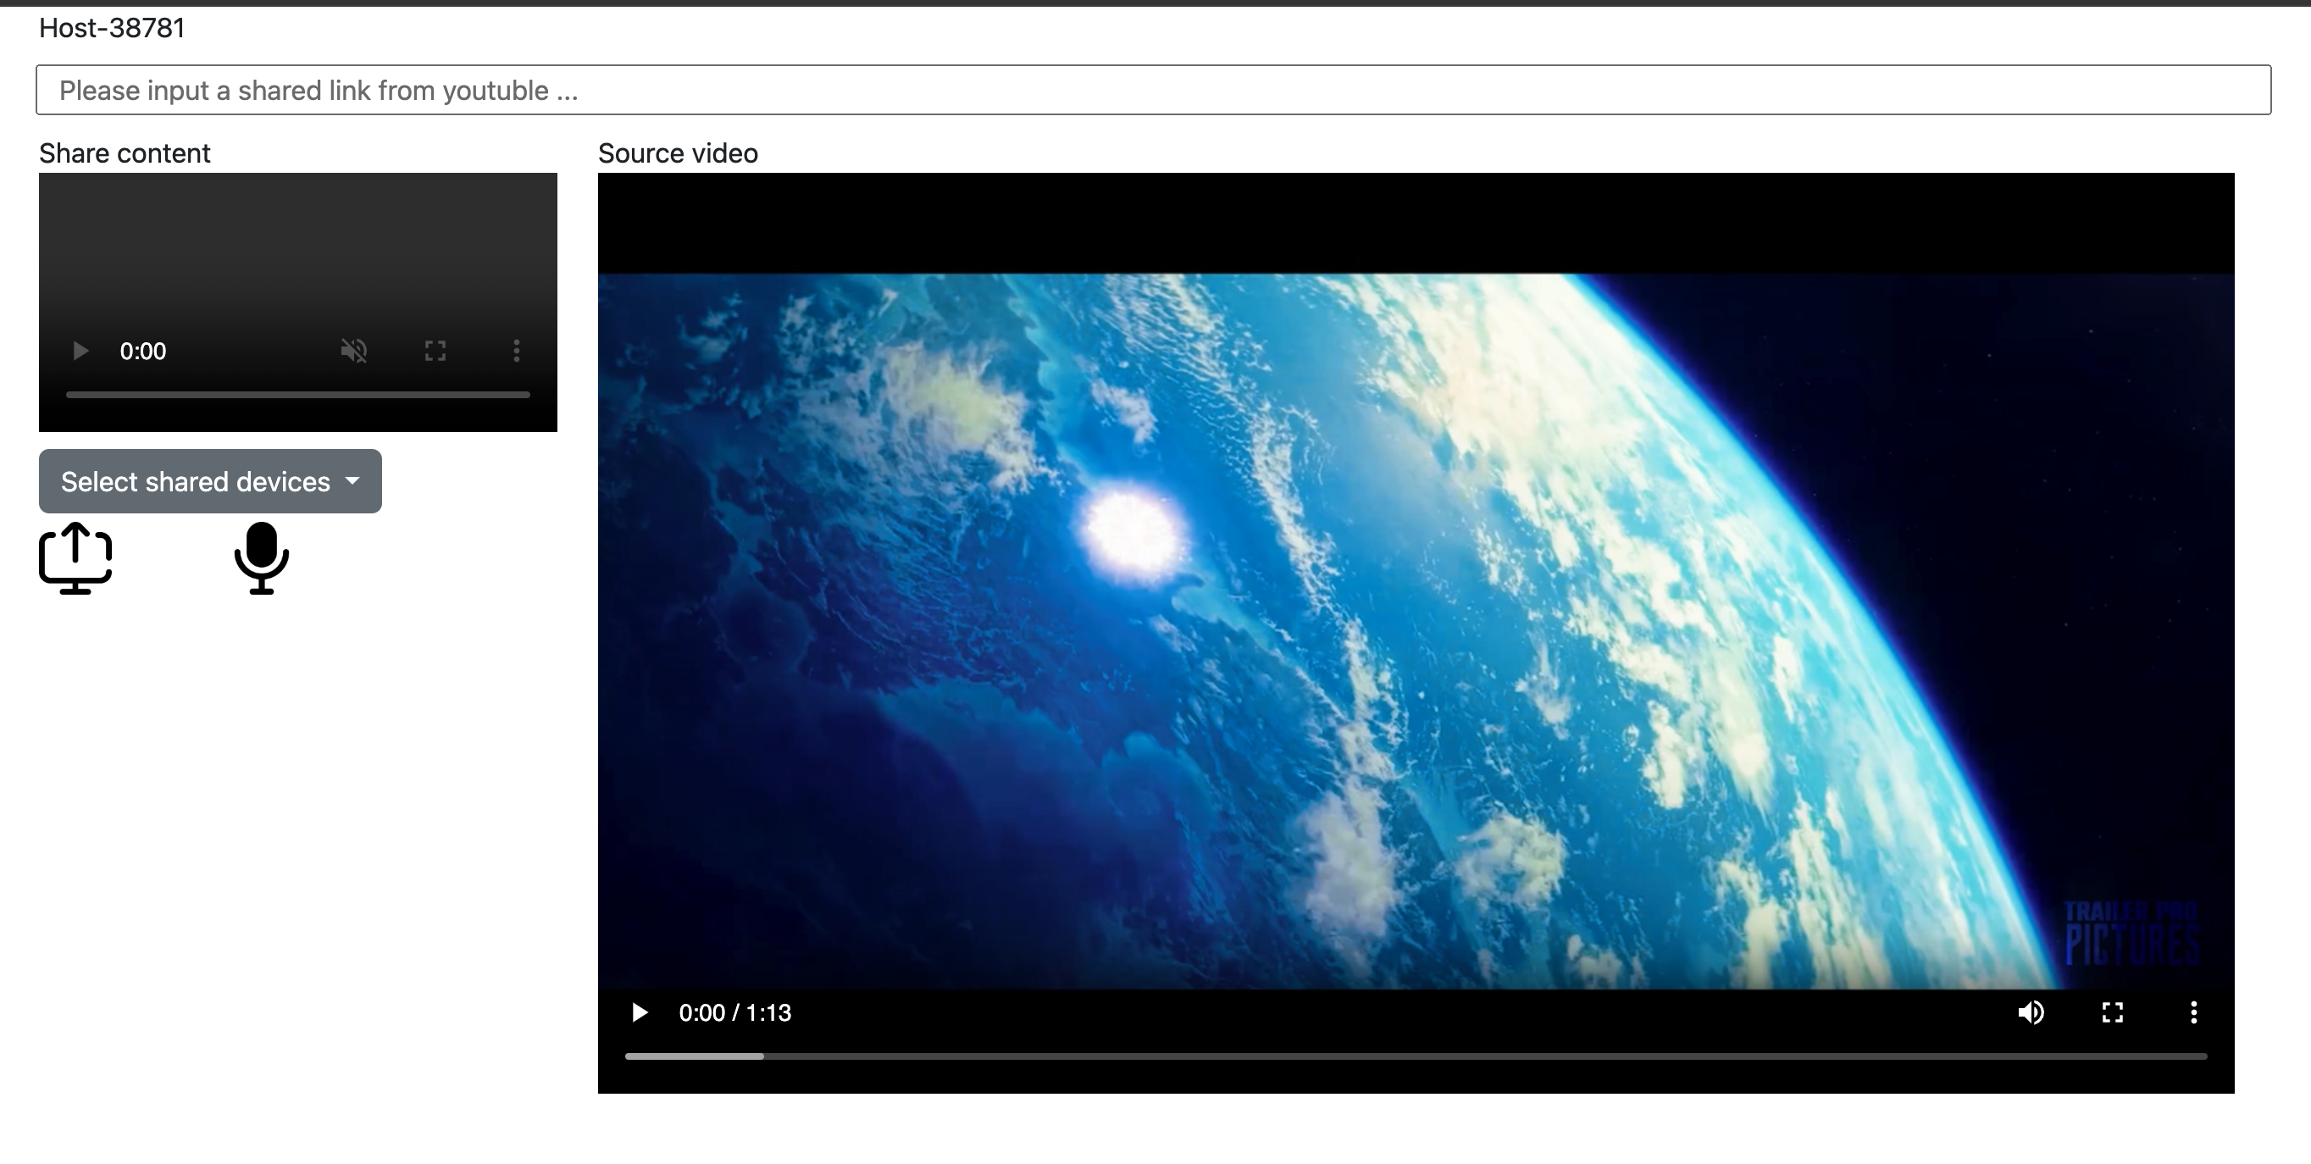
Demo browsers
random number to distinguish hosts
Display shared content
Display local video or youtube video
Display all available clients in check box
Start to stream

Slide 9
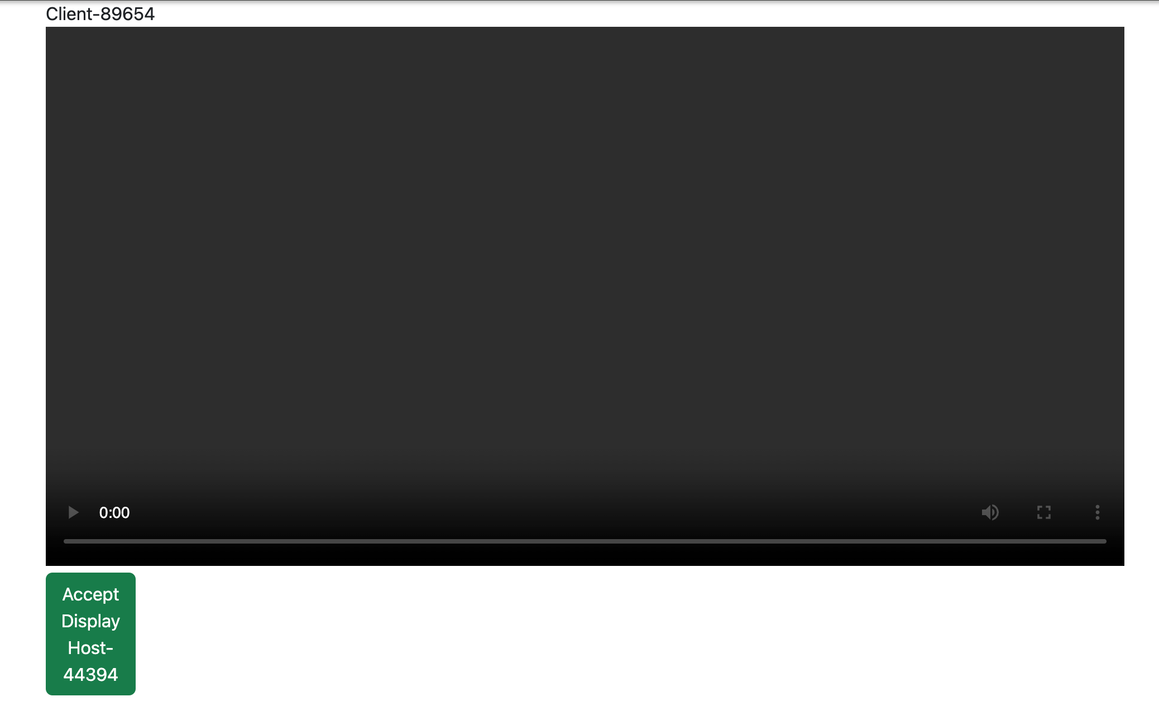
Demo browsers
random number to distinguish clients
Display shared content
Show current offer

Slide 10
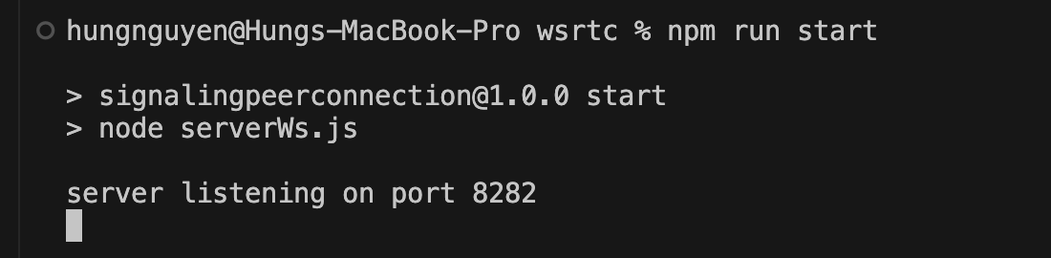
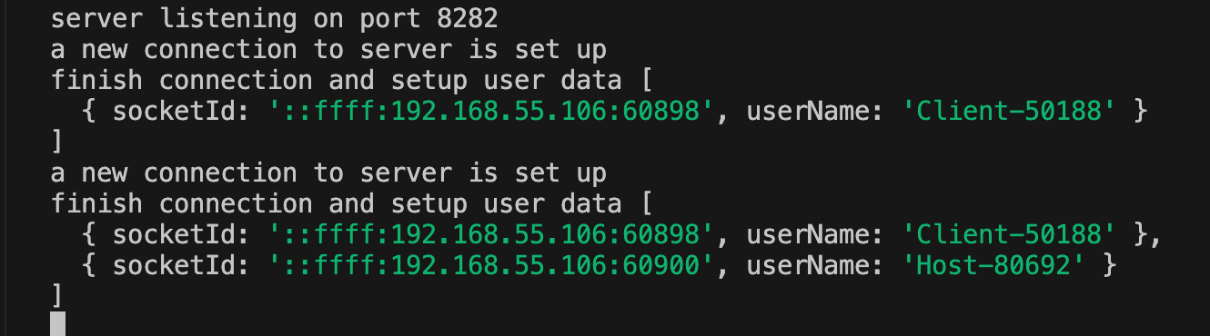
Run code and logs
Server listen at port 8282
Server display current connected list

Slide 11
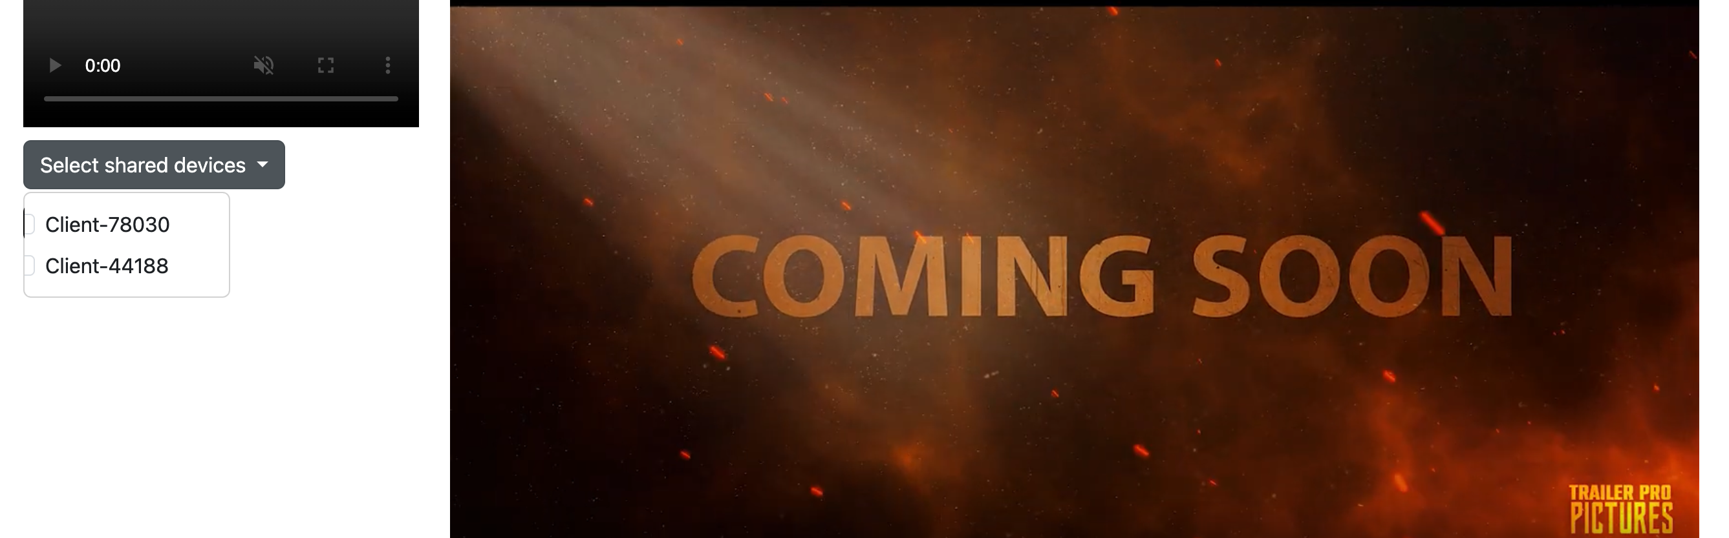
Select a shared device

Slide 12
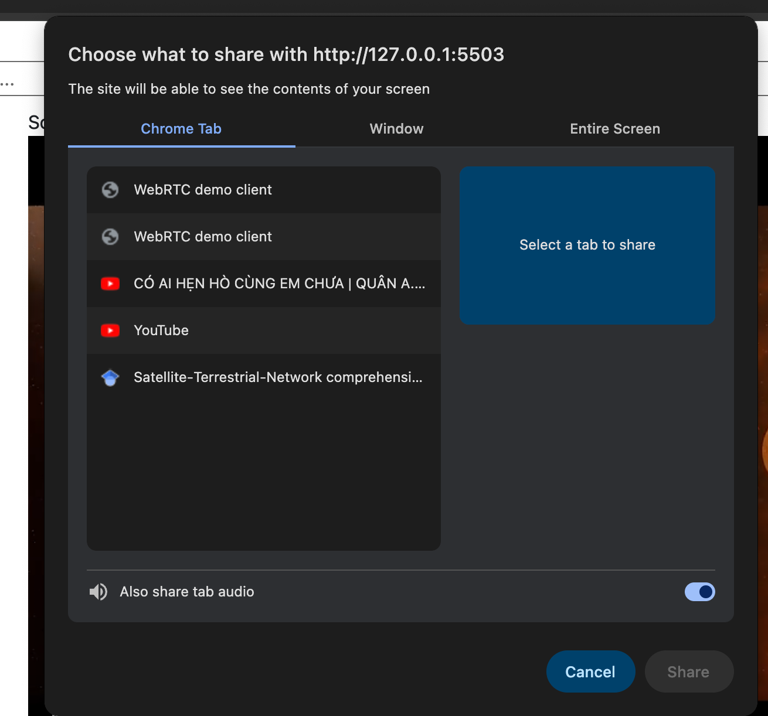
Select a window to start stream

Slide 13
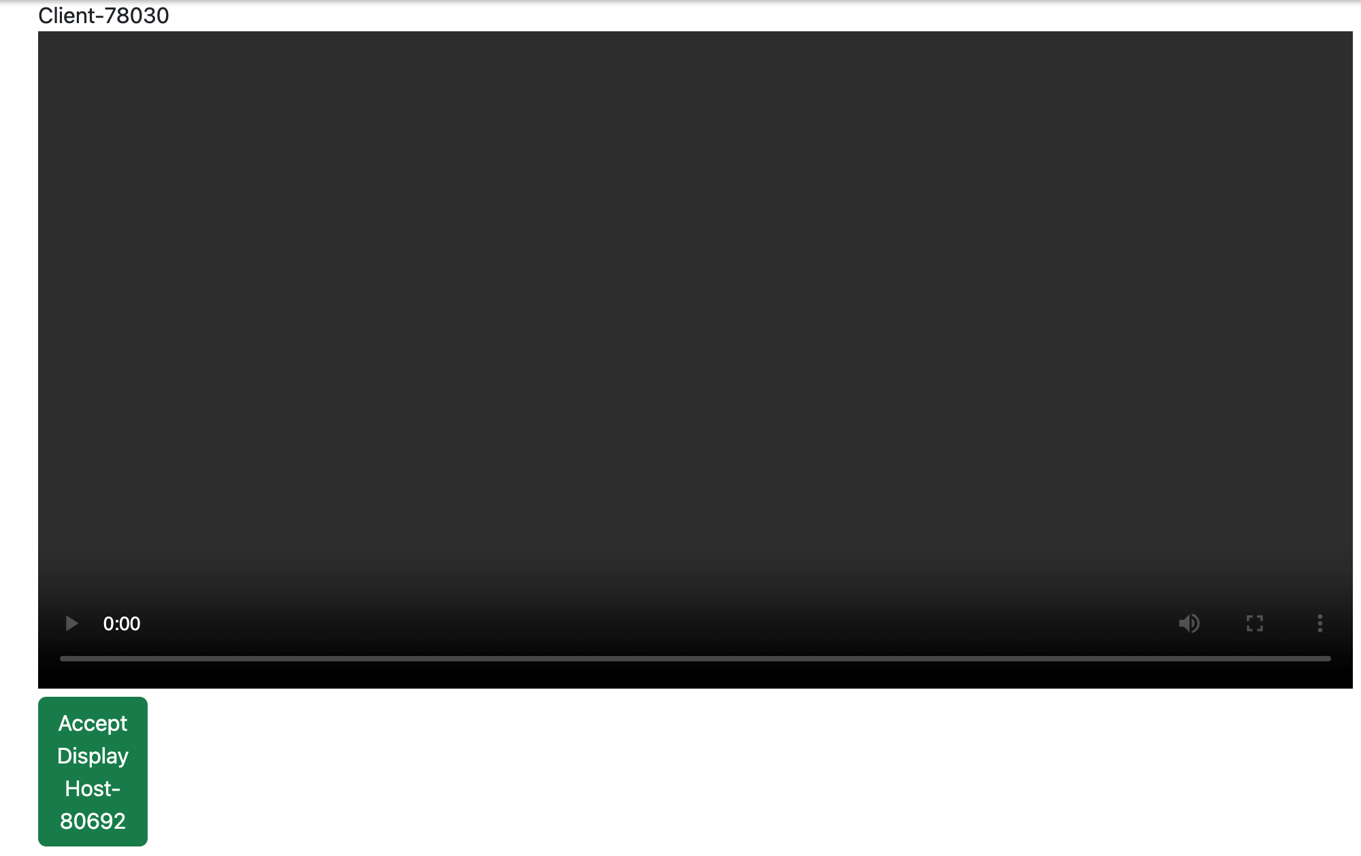
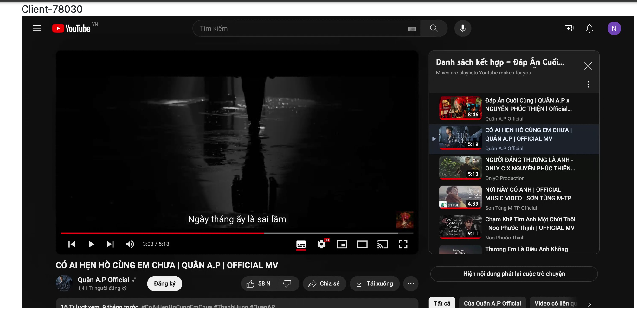
Accept and display

Slide 14
Thank you for listening

